Slide 1
Light up your app with the Composition API
Daren May - Custommayd
Windows Development MVP

Slide 2
What is the Fluent Design System?

Slide 3
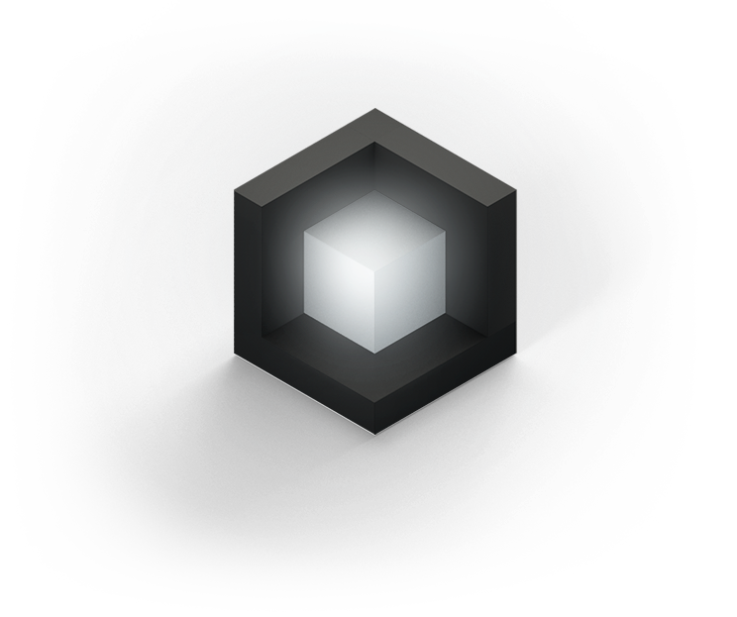
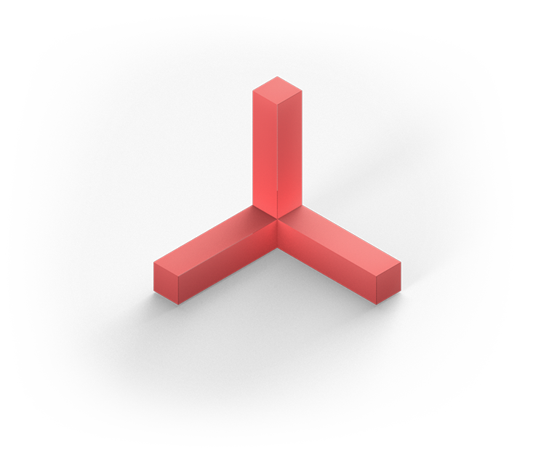

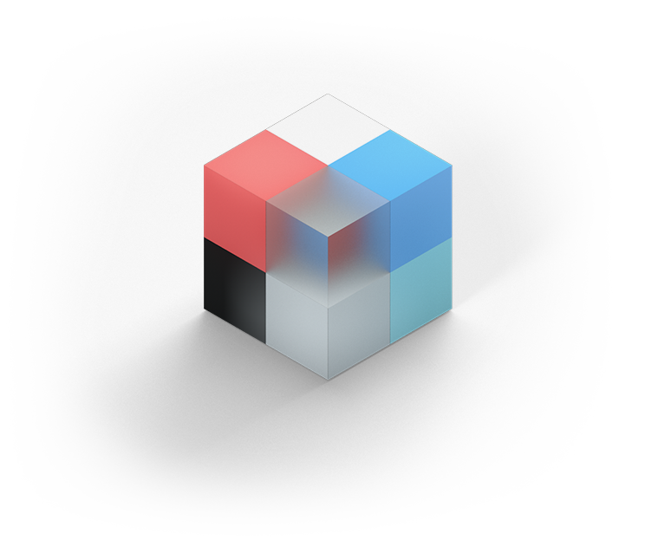

What is the Fluent Design System?
An evolving design language
Preserves cleanliness of MDL2
Guidance for Design and Interaction
Five Key Components:
Light
Depth
Motion
Material
Scale

Slide 4

What is the Fluent Design System?
A-B-C
Possible
Easy
Default
Incubating concepts.
Via the Graphics and Visual layers. In code.
Defined as a system.
Via the Framework and Visual layers. In markup and code. With authoring, diagnostic and debugging in Visual Studio.
Delivered end-to-end.
Formalized in design language.
Behaviors “packaged” in controls and libraries.

Slide 5
What is the Fluent Design System?
A-B-C
Possible
Easy
Default
Incubating concepts.
Via the Graphics and Visual layers. In code.
Defined as a system.
Via the Framework and Visual layers. In markup and code. With authoring, diagnostic and debugging in Visual Studio.
Delivered end-to-end.
Formalized in design language.
Behaviors “packaged” in controls and libraries.
Windows 10
Creators Update
Windows 10
Fall Creators Update
Windows 10
“The Future”

Slide 6
What is Composition?
Framework layer
Controls, Layout, Styling, Accessibility, Data binding, Pre-packaged behaviors & Patterns
Windows.UI.XAML
Visual layer
Lightweight visual rendering, Animations & Natural motion, Effects, Dimensionality, Lighting & Shadows
Windows.UI.Composition
Graphics layer
Drawing, Text rasterization, Shape & Vector rasterization, Ink rendering
DirectX Family

Slide 7
Video

Slide 8
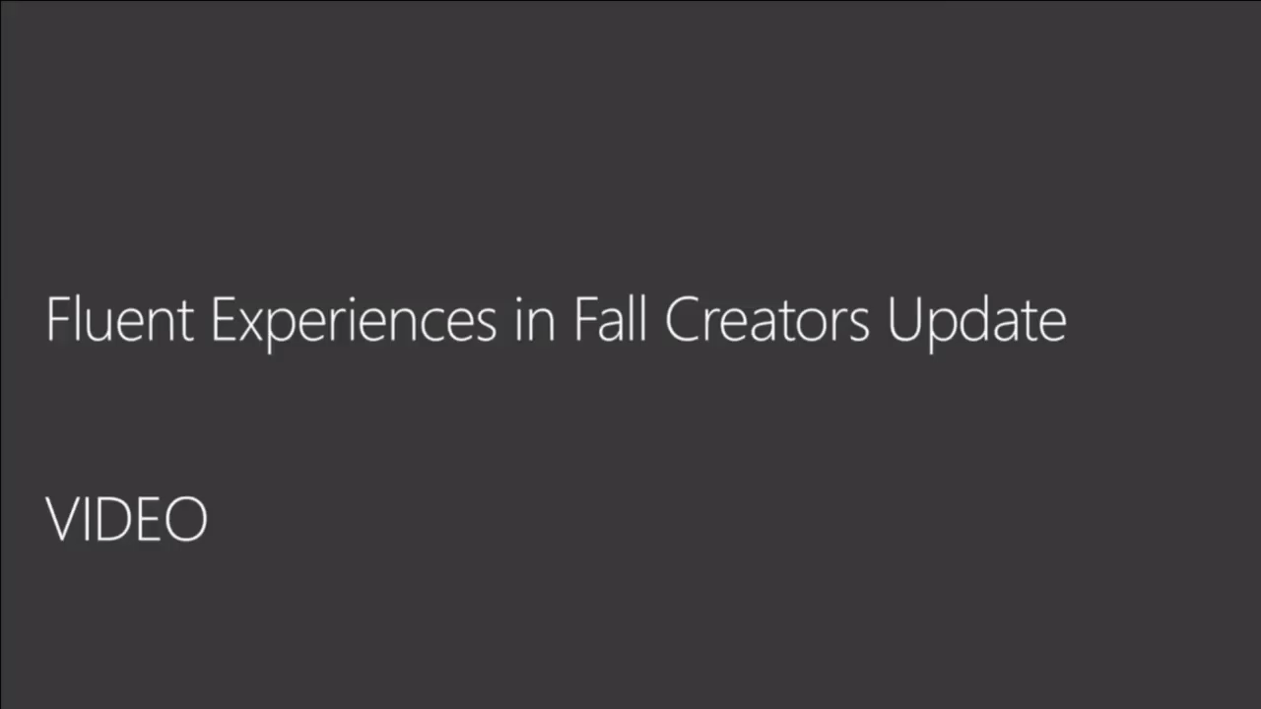

Slide 9
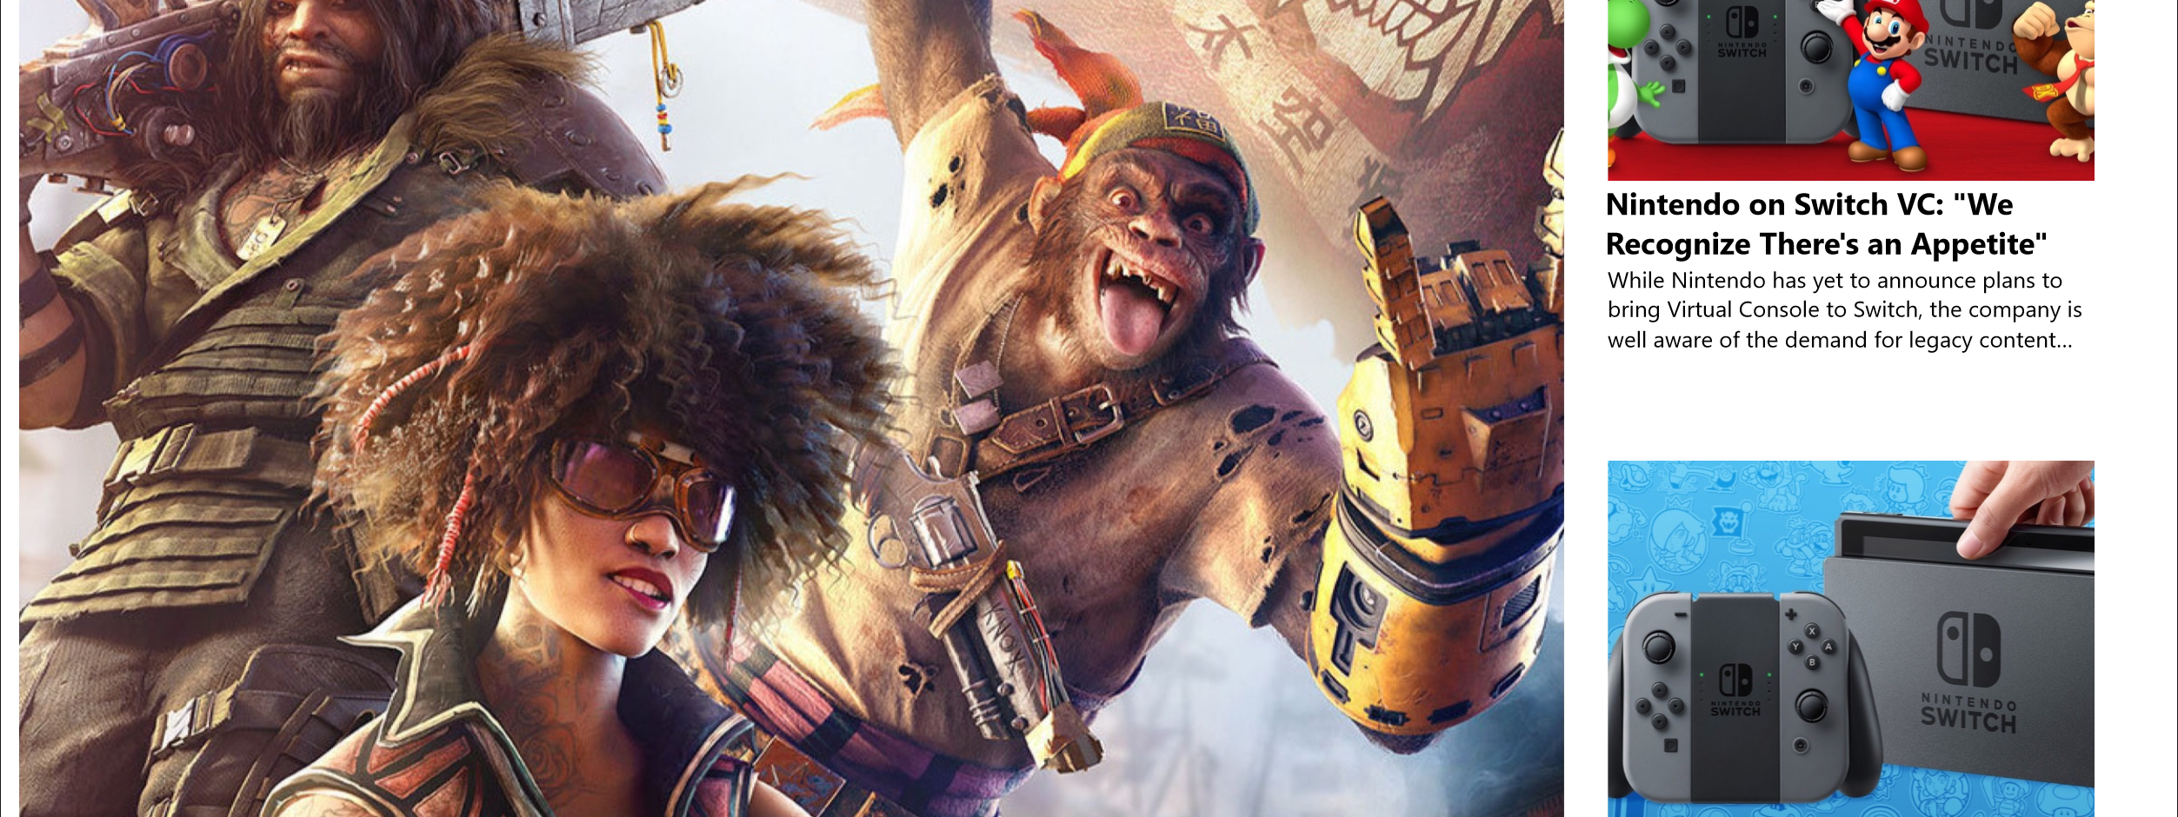
Let's Light it Up!

Slide 10
Checklist
Navigation View
Connected Animation
GridView Styles
Button Styles

Slide 11
References
http://fluent.microsoft.com/
https://docs.microsoft.com/en-us/windows/uwp/composition/visual-layer
https://github.com/Microsoft/WindowsUIDevLabs
https://docs.microsoft.com/en-us/windows/uwpcommunitytoolkit/
@darenmay
daren@custommayd.com
www.custommayd.com

